Slide 1

CGT Main Residence Exemption
Jordan Edwards
National Tax Training
October 2024
© 2025 Findex (Aust) Pty Ltd
1

Slide 2
To be covered
Adjacent land
Deriving income from a main residence
Keeping the exemption when demolishing or subdividing
Succession and deceased estates

Slide 3
General
The sale or transfer needs to be on capital account
Be cautious of property development, isolated profit-making scheme?
Only available to Australian tax resident individuals
One main residence between spouses (s 118-170).
Bare trust arrangements are fine due to absolute entitlement.
There must be a ‘dwelling’
Exhibit factors of residing/living in a residence, such as location of possessions, registered address under the electoral role, registered address for mailing purposes etc (TD 51 (withdrawn)).
Encompasses buildings, caravans, houseboats or other mobile homes (s 118-115) and extends to adjacent land (s 118-120).
Notes:
The sale or transfer needs to be on capital account.
It is not uncommon for “Mums and Dads” to decide to demolish their existing dwelling and build a new property, or properties, on that land.
Depending on the facts and circumstances, those activities may venture beyond the mere realisation of a capital asset and constitute an isolated profit-making transaction or the sale of trading stock.
The CGT MRE is generally only available to Australian tax resident individuals. This means companies and trusts cannot avail of the CGT MRE unless it can be substantiated that those entities are mere legal owners of the dwelling, and the individual is absolutely entitled to the asset.
Remember that a bare trust does not necessarily enliven absolute entitlement.

Slide 4
General
When does the “ownership period” begin and end?
Generally at settlement and not contract dates (s 118-120 and s 118-130).
Relevant for assessing the two year period if a beneficiary of a deceased estate seeks to dispose of the deceased’s main residence within two years of death.
Available to individuals who acquire an interest following a marriage breakdown
Individual needs to have acquired their interest in a dwelling because of a CGT rollover under 126-A ITAA 1997 (s 118-178 and s 118-180).
Notes:
When we are looking at claiming a partial MRE, the first thing we need to know is the “total days” in the ownership period.
MRE is available to an individual who acquires their interest in a dwelling because of CGT rollover under 126-A.

Slide 5
Adjacent Land

Slide 6
Adjacent land
Main residence exemption includes adjacent land.
Maximum area of adjacent land covered by the exemption is 2 hectares, less the area immediately under the dwelling (s 118-120).
Only available to the extent land was used primarily for private and domestic purposes, in association with the dwelling.
MRE does not apply to the adjacent land if the CGT event does not also happen to the dwelling (s 118-165).
Notes:
Most of us know that the MRE applies to adjacent land, and the maximum area of adjacent land covered is 2 hectares less the area immediately under the dwelling.
Only available to the extent the adjacent land was used for private and domestic purposes.
MRE does not apply if the CGT event does not also happen to the dwelling.

Slide 7
Which 2 hectares?
Adjacent land does not need to be contiguous to dwelling, but proximity is important (TD 1999/68).
For land which is greater than two hectares, TD 1999/67 allows taxpayers to choose which area of land qualifies as adjacent land (in addition to the land over which the dwelling is situated).
However, when choosing the area of land, it must be used primarily for private or domestic purposes.
This is typically most relevant for primary producers because their land typically serves a dual purpose as being the location of their dwelling as well as where they conduct their farming activities.
Notes:
A primary producer may need to assess which portion of the land qualifies as “adjacent land” as well as whether any other CGT concessions apply.

Slide 8
Example
Alistair owns a 10 hectare property - see the diagram.
He has selected the shaded area as the part of the land on which he wishes to claim the main residence exemption.
This area does not exceed 2 hectares and is used primarily for private or domestic purposes in association with Alistair's dwelling.
He sells the property for $500,000.
He obtains an opinion from an expert valuer that the value of the 2 hectares of land and the house is $300,000.
The cost base attributable to this part of the property (taking into account improvements since purchase) is $180,000 and the remainder is $120,000.
The capital gain on the total property is $200,000. Alistair disregards $120,000 of the capital gain because it is attributable to his main residence.
Source: TD 1999/67 (Example 2)

Slide 9
Vacant land not used for any purpose
Can land be “used for a private or domestic purposes” if the land is not being used for any purpose?
In a different context, when looking at the Maximum Net Asset Value Test, the ATO is of the opinion that vacant land “not being used for any purpose” does not fall within the definition of an asset used “soley for personal use and enjoyment” under s 152-20 (ATO ID 2009/34).
Should a taxpayer keep evidence that the vacant land was used for private and domestic use, for example, exercise, walking a dog, paddocking a pony, etc in association with the dwelling.

Slide 10
Income Producing Purpose

Slide 11
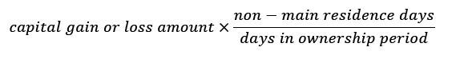
Income producing purpose
Taxpayers who use their dwelling to produce assessable income generally lose full main residence exemption (subject to absence rule, discussed later).
Partial main residence might still be available (s 118-185):
Does not include board or lodgings under a domestic family relationship (IT 2167).
Notes:
Be weary of those who live in their dwelling and
carry on a business;
lease a room in the dwelling; or
allow guests to stay via platforms like Airbnb

Slide 12
Cost base reset
Cost base reset to market value when property used to produce assessable income for the first time (s 118-192).
Resets acquisition dates. This impacts:
12-month period for CGT discount; and
Absence rule – if sold after six years then 118-185 excludes from the capital gain the portion of the gain that relates to the siz year extended main residence exemption.
Taxpayers do not get a choice in whether this applies or not!
Notes:
There is a special rule that resets a taxpayer’s cost base when the property in first used to produce assessable income.
This deems the acquisition date of the property to be at this date, which may impact availability of 50% general discount.
The interplay with the six year absence rule can get confusing as well. If the disposal of the dwelling is within the six year period, it is not relevant because the dwelling would be fully exempt anyway.
If the dwelling is sold after the six-year period expires, s 118-185 will exclude from the taxable capital gain the proportion of the capital gain that relates to the six-year extended main residence exemption period.

Slide 13
Cost base reset
Can only apply if:
The Property was first used for producing assessable income after 20 August 1996;
The taxpayer is only eligible for a partial exemption in relation to the dwelling as it was used for the purpose of producing assessable income during the taxpayer’s ownership period; and
The taxpayer would have been entitled to a full exemption if the CGT event had happened just before the first time it was used to produce assessable income.
Notes:
Worth noting that…

Slide 14
Absence Rule

Slide 15
Absence rule – s 118-145
Individuals who cease to occupy a dwelling and commence using it to derive assessable income can continue to treat the dwelling as their main residence for up to 6 years.
If not rented out, dwelling can be treated as main residence indefinitely.
Subject to whether taxpayer wants to treat another property as a main residence and foreign resident interactions.

Slide 16
No double dipping
If a taxpayer makes the choice, they cannot treat any other dwelling as their main residence while they apply this section.
However, a key exception affords taxpayers a period of up to 6 months to treat two properties as dwellings when moving from one to another (s 118-140).
Still need to have occupied the dwelling at some stage. Cannot commence using it for investment purposes and treat it as a main residence.

Slide 17
6 Year period can be reset
Six years does not need to be continuous.
The six year period can be reset by moving back in and vacating.

Slide 18
Oversees dwellings
Can a person who recently arrived in Australia, who has established Australian tax residency, apply the absence rule to an oversee dwelling?
S 855-45(3) deems the acquisition date as when a person becomes an Australian resident.
However, this does not mean that the asset was not owned by the taxpayer before they became a resident: TD 95/7.

Slide 19
Demolition and Subdivision

Slide 20
Demolition rule
To apply the main residence exemption under Subdiv. 118-B there needs to be needs to be dwelling.
The demolition of a dwelling is regarded as a CGT event and deemed disposal of a dwelling (CGT Event C1).
Although most taxpayers do not receive proceeds for such a demolition (and market value substitution rule does not apply to C1).
Notes:
Basic rule mentioned earlier is that you need a dwelling to claim the MRE.
Demolition of a dwelling is technically a C1 event, although generally no proceeds are received, and the market value substitution rule does not apply to C1.

Slide 21
Demolition rule
If the taxpayer then sells the vacant land, or subdivides and sells the new lots, they must account for any capital gain or capital loss they make on the sale.
As there is no dwelling on the land, the taxpayer is not entitled to claim a partial exemption for the period when there was a dwelling occupied as their main residence.
The MRE will be available if the sale occurs whilst a dwelling that is the taxpayer’s main residence remains on the land they sell.
Notes:
Default position is that if the taxpayer sells the vacant land, they must account for any capital gain or loss.
If they subdivide, and build multiple properties, they can obtain the MRE exemption again if they later move into that property, but only for that one property.

Slide 22
Demolition rule
If a taxpayer decides to rebuild after demolishing the dwelling, section 118-150 provides that the main residence exemption can still be claimed if:
the taxpayer makes a choice to treat the vacant land as their main residence from the time the demolished dwelling was last occupied; and
there is no more than four years between the time of last occupation of the demolished dwelling and the time the new dwelling becomes the taxpayer’s main residence.
the taxpayer moves into the new dwelling ‘as soon as practicable’ after construction and lives in the newly constructed dwelling for at least three months.

Slide 23
What is ‘as soon as practicable’?
TD 92/147 says this is:
when the certificate of occupancy is issued;
the date final building inspection approval is provided;
the date the dwelling becomes structurally complete; and
the date when utility connections are finalised.

Slide 24
Deceased Estates

Slide 25
Deceased estates
A taxpayer can disregard a capital gain or loss from a CGT event that happens in relation to their ownership interest in a dwelling if (s 118-195):
The taxpayer is an individual;
The interest in the dwelling passed from a deceased estate (i.e. you are a beneficiary or trustee of that estate);
The deceased is not an excluded foreign resident; and
Notes:
MRE can extend to dwellings passed down through an estate.
Need to be an individual that is a trustee or beneficiary of the estate who is not an excluded foreign resident.

Slide 26
Deceased estates
4. If deceased acquired post CGT and:
the dwelling was the deceased's main residence just before the deceased's death and was not then being used for the purpose of producing assessable income; and
The taxpayer’s ownership interest ends within two years of the deceased’s death (or such other time allowed by the Commissioner – refer to PCG 2019/5 for guidance); or
Ownership interest ends at settlement date, not contract date.
Notes:
If deceased acquired post CGT asset and it was their main residence prior to their passing: the taxpayer’s ownership interest needs to end within two years from the deceased’s DOD.
PCG 2019/5 allows further time (e.g. will being challenged, life tenancy delays disposal, complexity of deceased estate or other circumstances outside taxpayer’s control).

Slide 27
Deceased estates
5. If deceased acquired pre-CGT and:
the dwelling was, from the deceased's death until your ownership interest ends, the main residence of one or more of:
the spouse of the deceased immediately before death; or
an individual who had a right to occupy the dwelling under the deceased’s will; or
if the CGT event was brought about by the individual to whom the ownership interest passed as a beneficiary - that individual.
First element cost base for beneficiary is market value at date of death anyway (s 128-15(4)).

Slide 28
Deceased estates
Extends to testamentary trusts (ATO ID 2004/882 and ATO ID 2006/34).
A taxpayer who acquires a dwelling as a surviving joint tenant is treated as acquiring the dwelling as a beneficiary of a deceased estate (s 118-197).
Notes:
Extends to testamentary trusts and covers taxpayers who acquire a dwelling as a surviving joint tenant.

Slide 29
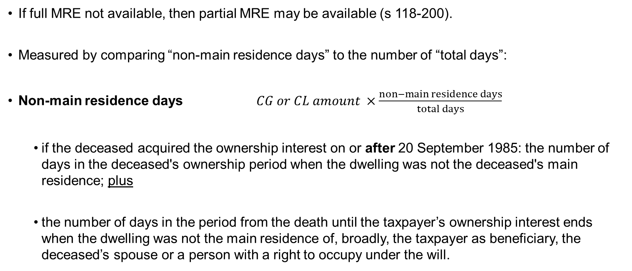
Deceased estates
If full MRE not available, then partial MRE may be available (s 118-200).
Measured by comparing “non-main residence days” to the number of “total days”:
Non-main residence days $CG or CL amount ×\frac{non−main residence days}{total days}$
if the deceased acquired the ownership interest on or after 20 September 1985: the number of days in the deceased's ownership period when the dwelling was not the deceased's main residence; plus
the number of days in the period from the death until the taxpayer’s ownership interest ends when the dwelling was not the main residence of, broadly, the taxpayer as beneficiary, the deceased’s spouse or a person with a right to occupy under the will.
Notes:
Partial MRE is also available – I won’t go into the calcs due to time.

Slide 30
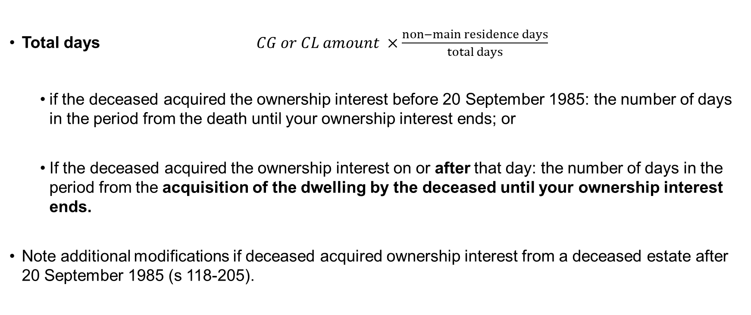
Deceased estates
Total days $CG or CL amount ×\frac{non−main residence days}{total days}$
if the deceased acquired the ownership interest before 20 September 1985: the number of days in the period from the death until your ownership interest ends; or
If the deceased acquired the ownership interest on or after that day: the number of days in the period from the acquisition of the dwelling by the deceased until your ownership interest ends.
Note additional modifications if deceased acquired ownership interest from a deceased estate after 20 September 1985 (s 118-205).

Slide 31
Interaction with 6 year absence rule?
What if deceased was renting out post-CGT dwelling at the time of death but using the 6-year absence rule under s 118-45?
Is the full CGT main residence exemption available for beneficiary or trustee of estate?
Some ATO Private Rulings suggest full MRE is available so long as conditions in s 118-195 are met:
ATO Private Ruling Authorisation Number: 1011956365911 and 1011956365911.
Notes:
Final comment is what about deceased estates where the deceased was using the 6 year absence rule?
Common scenario, you might have an older taxpayer who has moved into a nursing home, and passed away within the 6 year period.

Slide 32
Thank You
32

Slide 33
Disclaimer
Crowe Global is a leading international network of separate and independent accounting and consulting firms that are licensed to use “Crowe” in connection with the provision of professional services to their clients. Crowe Global itself is a non-practicing entity and does not provide professional services to clients. Services are provided by the member firms. Crowe Global and its member firms are not agents of, and do not obligate, one another and are not liable for one another’s acts or omissions.
© 2025 Crowe Global
Findex (Aust) Pty Ltd, trading as Crowe Australasia is a member of Crowe Global, a Swiss verein. Each member firm of Crowe Global is a separate and independent legal entity. Findex (Aust) Pty Ltd and its affiliates are not responsible or liable for any acts or omissions of Crowe Global or any other member of Crowe Global. Crowe Global does not render any professional services and does not have an ownership or partnership interest in Findex (Aust) Pty Ltd.
Services are provided by Findex (Aust) Pty Ltd and affiliated audit partnerships (Findex).
© 2025 Findex (Aust) Pty Ltd. All rights reserved.
Findex (Aust) Pty Ltd ABN 84 006 466 351
While all reasonable care is taken in the preparation of the material in this document, to the extent allowed by legislation Findex accept no liability whatsoever for reliance on it. All opinions, conclusions, forecasts or recommendations are reasonably held at the time of compilation but are subject to change without notice. Findex assumes no obligation to update this material after it has been issued. You should seek professional advice before acting on any material.
The title ‘Partner’ conveys that the person is a senior member within their respective division and is among the group of persons who hold an equity interest (shareholder) in its parent entity, Findex Group Limited. The only professional service offering which is conducted by a partnership is external audit, conducted via the Crowe Australasia external audit division and Unison SMSF Audit. All other professional services offered by Findex Group Limited are conducted by a privately owned organisation and/or its subsidiaries.
Some of the Crowe personnel involved in preparing this document may be members of a professional scheme approved under Professional Standards Legislation such that their occupational liability is limited under that Legislation. To the extent that applies, the following disclaimer applies to them. If you have any questions about the applicability of Professional Standards Legislation to Crowe’s personnel involved in preparing this report, please speak to your Crowe adviser.
Liability limited by a scheme approved under Professional Standards Legislation.

